Slide 1
Allstate Connected car
How to make people better drivers?

Slide 2
Causes for car accidents
Speeding
Alcohol
Bad Weather
Distraction

Slide 3

Speeding
Find speed using Allstate Sensor’s API
If the speed exceeds the limit then using Speech synthesis API we can announce the message like lower the speed or something.

Slide 4
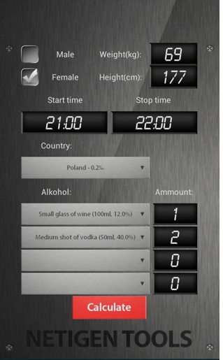
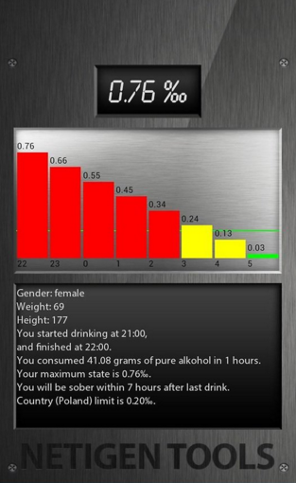
Alcohol consumption
Alcohol test
Bonus points if the driver takes the test before driving

Slide 5
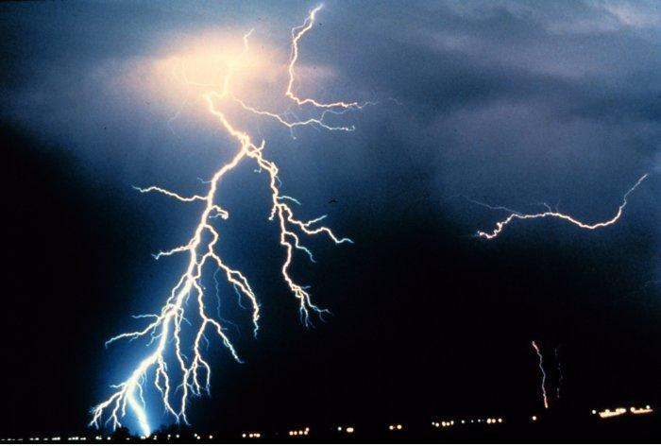
Bad weather
Using Location awareness API get the location.
Emergency weather alert notifications by using ACCUweather API or yahoo weather API.

Slide 6
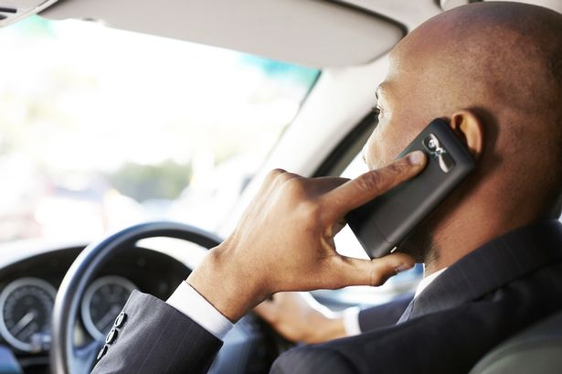
Less usage of cell phone
If the driver uses hands free to take the call then add bonus points
we can make texting while driving more safer by using Web Speech API, which converts the speech to text.

